Slide 1

HACK-A-STAT-25
Hackverse
Team name:
Members:
Aayushi Fariya
Sayali Mahurkar
Sneha Maheshwari

Slide 2

PROBLEM STATEMENT:
You are provided with a dataset of 10 years (1999-2008) representing hospital records of patients with diabetes who underwent laborartory, medication and stayed up to 14 days. The goal is to determine the readmission of the subject within 30 days of discharge.

Slide 3







OBJECTIVES
Conduct exploratory data analysis to uncover significant trends and outliers in the dataset.
Develop strategies to handle missing data effectively for predictive modeling.
Enhances Understanding
Demonstrates Respect
Assess the relationship between HbA1c levels and hospital readmissions using a binary classification model.
Analyze changes in diabetes medication based on varying HbA1c measurements.
Identify and address multi-collinearity among variables.
Validate and evaluate the predictive model's performance metrics.

Slide 4
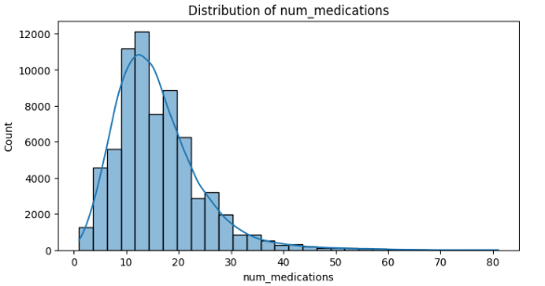
Exploratory Data Analysis (EDA)
Medication Trends:
Avg. medications: 15.8; max: 81; indicates potential over-prescription.
Lab Procedures:
Avg. procedures: 43; suggests excessive testing frequency.
Race Distribution:
Caucasians dominate due to hospital's U.S. location.
Dosage Changes:
80% steady, 10% increased, 10% decreased insulin dosage.
Diagnosis Trends:
Circulatory diseases dominate; longer stays linked to readmissions.
Outliers:
Medication and procedure counts (<15%) retained for analysis.

Slide 5





DATA CLEANING
Handling Missing Data:
Outlier Treatment:
Special Value Processing:
Dropping columns like Weight with >90% missing values.
Mode imputation for MCAR variables with small missing percent.
Random Forest for categorical data. imputation
Retained outliers (<15%) to preserve data integrity.
.
Replaced "None" in max_glu_serum and A1Cresult with "No," as they indicate no test rather than missing data.

Slide 6
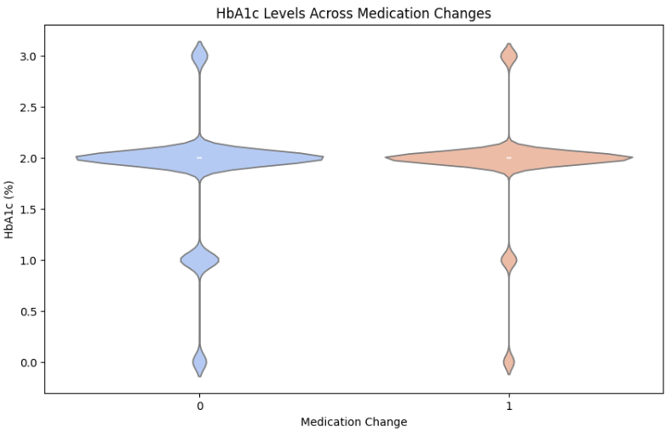
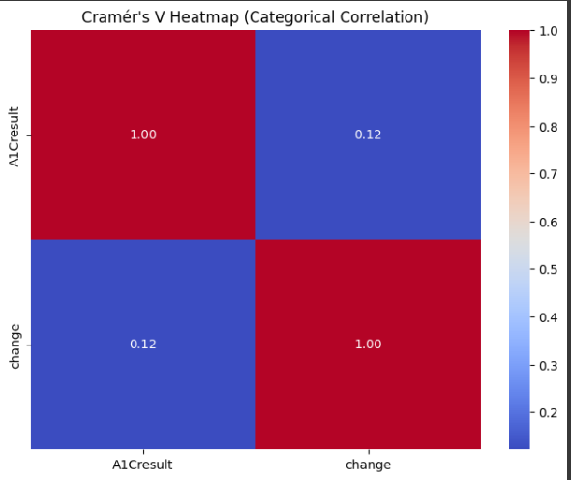

Slide 7
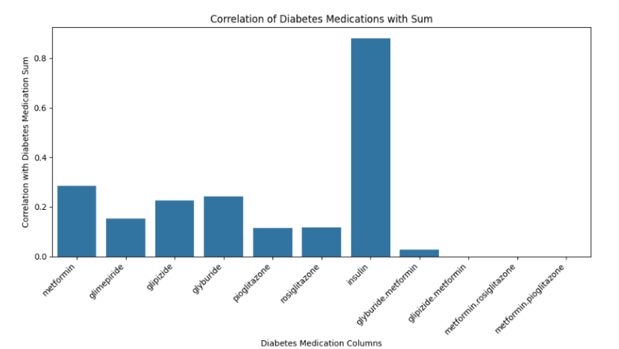
The new variable DM, created by summing drug effects, shows a strong correlation with insulin levels, likely due to insulin being the most prescribed diabetes medication.

Slide 8
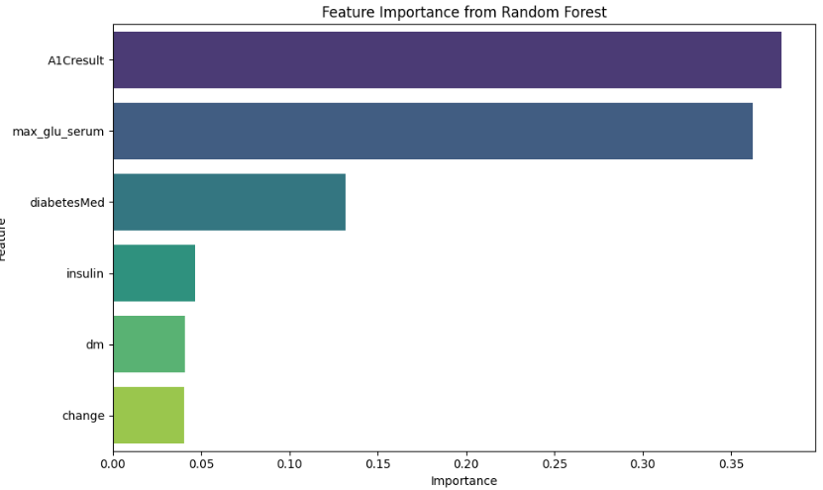

Slide 9
Methodology
Handling Missing Values:
Admission Type ID, Race, Discharge Disposition ID: Imputed using mode due to low missing values (~10%) and MCAR nature.
Weight: Removed due to 96% missing values.
Medical Specialty: Imputed using Random Forest due to high missing values (48%) and its ability to handle categorical data without assumptions
Analysis of HbA1c and Medication Changes
Chi-Square Test: Assessed correlations between HbA1c levels and medication changes.
Confusion Matrix: Visualized changes for HbA1c categories (No test, Normal, >7, >8).
Predictive Modeling for Readmission
Models: Logistic Regression, Random Forest, XGBoost.
Focus: Impact of HbA1c levels on readmission, addressing non-linear and imbalanced data.

Slide 10

Analysis and Results
Feature Selection: Chi-Square test identified key features like age, race, A1Cresult, and change.
Imputation: Missing values in Medical Specialty imputed using Random Forest (e.g., Internal Medicine: 29,805 cases).
HbA1c & Medication Change:
Equal patients had medication changes despite no HbA1C test (~1320 vs. 1394).
Unexpected adjustments for HbA1C >7 suggest other conditions.
HbA1C >8: 1547 patients had no medication change; further review needed.
Multicollinearity:
Variables with VIF > 10 resolved by combining features.
Final VIF: All < 10, no multicollinearity.
Dimensionality Reduction: Applied PCA for simplification.

Slide 11
Model | Class | Precision | Recall |  | Accuracy | F1_score | support
Logistic Regression |  | - | - |  | 0.94 | - | -
Randomforest Classifier | 0 1 | 0.950.08 | 0.910.15 |  | 0.93 | 0.960.06 | 13151621
XGboost | 0 1 | 0.950.12 | 0.990.04 |  | 0.67 | 0.970.06 | 105955
Results
Model | Class | Precision | Recall | Accuracy | F1_score | support
Logistic Regression | 0 1 | 0.950.12 | 1.00- | 0.95 | 0.98- | 13151621
Balanced Randomforest Classifier | 0 1 | 0.970.08 | 0.740.45 | 0.95 | 0.840.13 | 13151621
XGboost | 0 1 | 0.960.38 | 1.000.01 | 0.95 | 0.980.02 | 13151621
Balanced Randomforest Classifier - most balanced model,
high accuracy is a priority-Logistic Regression might be more suitable.

Slide 12

CONCLUSION
Understanding readmission factors allows better resource allocation, improving medication prescribing and overall healthcare quality. EDA on drug results helps pharma companies assess drug efficacy and identify optimal combinations for diagnosing medical conditions.
LIMITATION AND FURTURE SCOPE
The data has high dimensions and is highly imbalanced. Newer methods to tackle feature imbalance can be used apart from using SMOTE for class imbalance data
APPENDIX

Slide 13

Thank You

